Slide 1
Database Normalization: Understanding Normal Forms and Data Anomalies
Notes:
Created from: https://www.youtube.com/watch?v=GFQaEYEc8_8

Slide 2
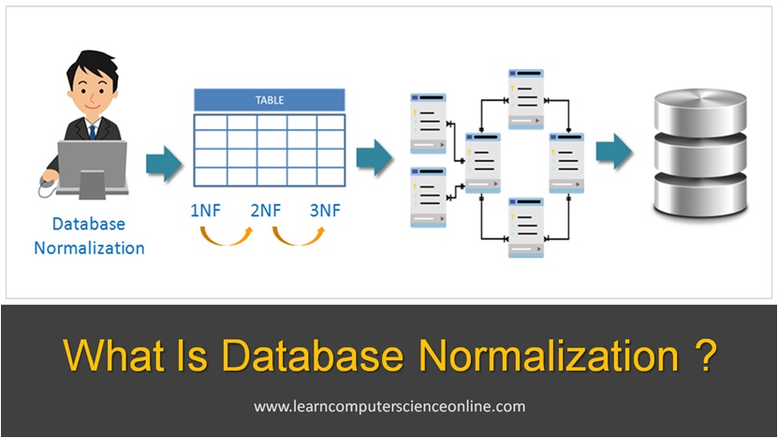
Welcome to Database Normalization
Opening Circle: Turn to a partner and share one thing you know about organizing data
Today you'll master the principles of database normalization [1][2]
Learning Target: You will understand normal forms and identify data anomalies
Why it matters: Proper database design prevents data inconsistencies and storage waste
Notes:
Image from: https://www.learncomputerscienceonline.com/database-normalization/

Slide 3
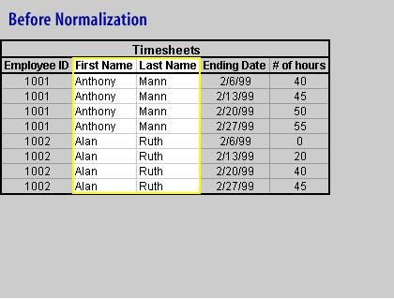
What is Database Normalization?
Database normalization is the process of organizing data to reduce redundancy [2][3]
Think of it like organizing your closet - everything has its proper place
Goals: Eliminate duplicate data, ensure data consistency, and improve storage efficiency
Think-Pair-Share: Discuss with a partner why duplicate data might be problematic
Notes:
Image from: https://www.relationaldbdesign.com/sql-database-creation/module3/databaseNormalization-definition.php

Slide 4
The Problem: Data Anomalies
Data anomalies occur when databases aren't properly normalized [1][3]
Three main types: Insertion, Update, and Deletion anomalies
These problems lead to inconsistent and unreliable data
Real-world impact: Imagine a school database with student information scattered everywhere

Slide 5
Insertion Anomalies Explained
Insertion Anomaly: Difficulty adding new data due to missing related information [1][3]
Example: Cannot add a new student without assigning them to a course
This happens when unrelated data is stored in the same table
Compass Points Activity: Move to corners based on how often you've encountered this problem

Slide 6
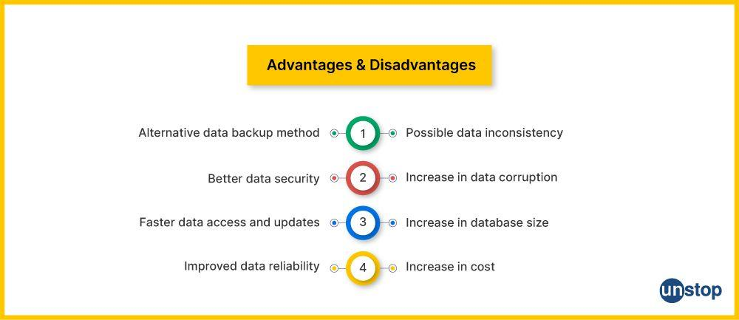
Update Anomalies in Action
Update Anomaly: Inconsistent data after updating redundant copies [1][3]
Example: Changing a department name in one place but forgetting others
Results in conflicting information across your database
Back-to-Back, Face-to-Face: Share examples of inconsistent information you've seen
Notes:
Image from: https://unstop.com/blog/data-redundancy-in-dbms

Slide 7
Deletion Anomalies Consequences
Deletion Anomaly: Unintended loss of important data when deleting records [1][3]
Example: Deleting a course removes all student enrollment information
This happens when related data is stored together inappropriately
Reflection Question: How might this affect a school's record-keeping?

Slide 8
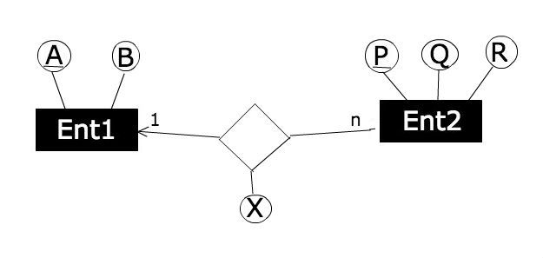
Understanding Functional Dependencies
Functional Dependency: When one attribute uniquely determines another (A → B) [1][2][4]
Example: Student ID determines Student Name
Key concept for understanding normal forms 1NF through BCNF
Think-Pair-Share: Identify functional dependencies in a student record
Notes:
Image from: https://stackoverflow.com/questions/49302584/determining-functional-dependencies-from-an-er-diagram

Slide 9
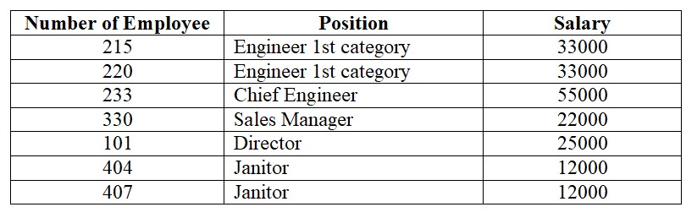
Multivalued Dependencies Explained
Multivalued Dependency: Independent multi-valued attributes dependent on one key [1][5]
Example: A student can have multiple hobbies AND multiple phone numbers independently
Different from functional dependencies - involves multiple independent values
This concept becomes important in Fourth Normal Form (4NF)
Notes:
Image from: https://www.bestprog.net/en/2020/10/27/databases-normalization-functional-dependencies-of-attributes-examples-building-functional-dependency-diagrams/

Slide 10
First Normal Form (1NF) Rules
Each table cell must contain atomic (indivisible) values [1][2][4][7]
No repeating groups or arrays allowed in cells
Each row must be unique with a primary key
Example: Instead of "Math, Science, English" in one cell, create separate rows

Slide 11
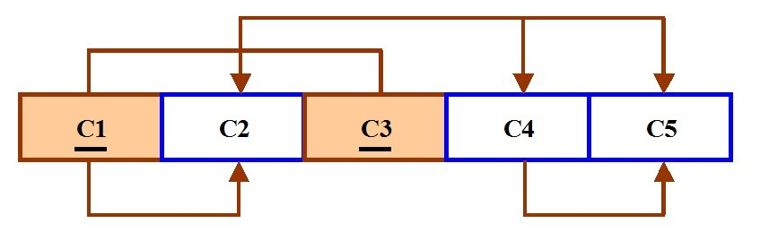
1NF Practice Activity
Examine this unnormalized table with multiple phone numbers in one cell
Compass Points: North (violates atomicity), South (violates uniqueness), East (both), West (neither)
Work with your corner group to identify 1NF violations
Learning Target Check-in: Can you identify atomic value requirements?
Notes:
Image from: https://eng.libretexts.org/Bookshelves/Computer_Science/Databases_and_Data_Structures/Database_Design_2e_(Watt)/01%3A_Chapters/1.12%3A_Normalization

Slide 12
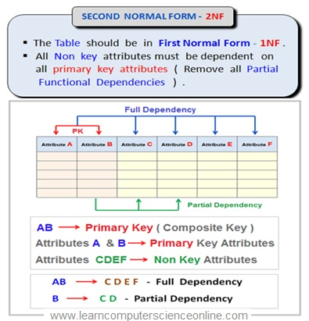
Second Normal Form (2NF) Requirements
Applies only when you have a composite primary key [1][2][4][6]
All non-key attributes must depend on the entire primary key
No partial dependencies allowed
Example: In a Student-Course table, grade depends on both Student ID AND Course ID
Notes:
Image from: https://www.learncomputerscienceonline.com/relational-database/

Slide 13
Identifying Partial Dependencies
Partial Dependency: Non-key attribute depends on only part of composite key [1][2][4]
Example: Student Name depends only on Student ID, not Course ID
This violates 2NF and causes redundancy
Think-Pair-Share: Find partial dependencies in a course enrollment table

Slide 14
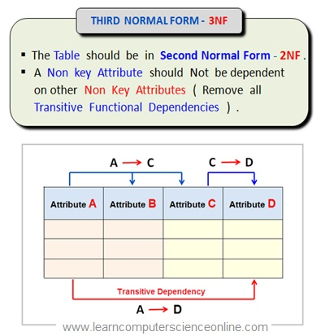
Third Normal Form (3NF) Principles
No transitive dependencies allowed [1][2][4][5]
Non-key attributes must depend only on the primary key
Not on other non-key attributes
Example: Student → Department → Department Head violates 3NF
Notes:
Image from: https://www.learncomputerscienceonline.com/relational-database/

Slide 15
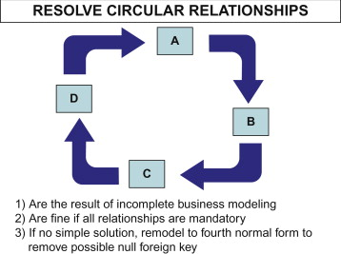
Eliminating Transitive Dependencies
Transitive Dependency: A → B → C where A is the key [1][2][4]
Solution: Create separate tables for each dependency
Back-to-Back, Face-to-Face: Explain transitive dependencies to your partner
Reflection Question: Why do transitive dependencies cause problems?
Notes:
Image from: https://www.sciencedirect.com/topics/computer-science/partial-dependency

Slide 16
Boyce-Codd Normal Form (BCNF)
Stricter than 3NF - every determinant must be a candidate key [1][2][4][5]
Removes remaining anomalies that 3NF might miss
Determinant: Any attribute that functionally determines another
Most practical databases aim for BCNF compliance

Slide 17
Fourth Normal Form (4NF) Advanced
Removes multi-valued dependencies [1][5]
No table should have two or more independent multi-valued attributes
Example: Student with multiple hobbies AND multiple phone numbers
Solution: Create separate tables for each multi-valued relationship

Slide 18
Fifth Normal Form (5NF) Expert Level
Eliminates join dependencies not implied by candidate keys [1][5]
Ensures lossless join decomposition
Most complex normal form - rarely needed in practice
Used in highly specialized database applications

Slide 19
Normalization Process Summary
Start with unnormalized data and apply rules progressively
1NF → 2NF → 3NF → BCNF → 4NF → 5NF
Each level builds on the previous one
Compass Points: Which normal form is most important for everyday use?

Slide 20
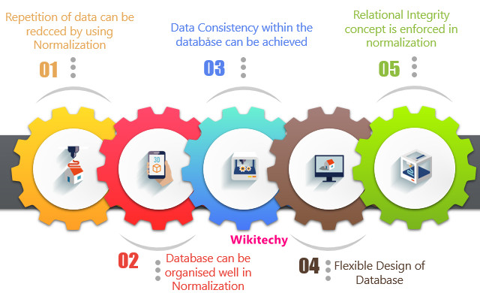
Benefits of Proper Normalization
Eliminates data redundancy and saves storage space [2][3]
Prevents insertion, update, and deletion anomalies
Ensures data consistency and integrity
Makes database maintenance easier and more reliable
Notes:
Image from: https://www.wikitechy.com/interview-questions/dbms/what-is-the-advantages-of-normalization-in-database/

Slide 21
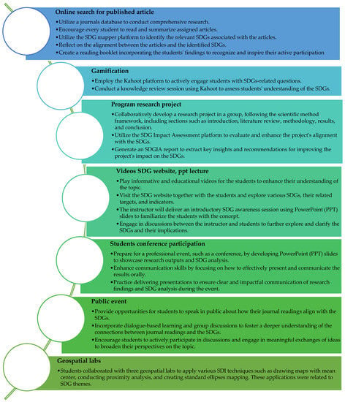
Closing Circle and Reflection
Exit Ticket: Name one normal form and its key requirement
Appreciations: Recognize classmates who helped you understand concepts
Goal Setting: Which normalization concept needs more practice?
Final Reflection: How will proper database design impact your future projects?
Notes:
Image from: https://www.mdpi.com/2071-1050/15/16/12394

Slide 22
Sources
[1] https://www.youtube.com/watch?v=GFQaEYEc8_8
[2] https://www.geeksforgeeks.org/dbms/normal-forms-in-dbms/
[3] https://www.digitalocean.com/community/tutorials/database-normalization
[4] https://codefinity.com/courses/v2/5ac24d9d-4a16-45b3-8856-07dec028c5e9/1ae84587-37c3-434a-a228-904a7b0951b5/f7797d90-b825-4886-b55b-0646376b0249
[5] https://celerdata.com/glossary/normalization-vs-denormalization-the-trade-offs-you-need-to-know

